Slide 1
Chapter 14: Protection

Slide 2
Chapter 14: Protection
Goals of Protection(保护目标)
Principles of Protection(保护原则)
Domain of Protection(保护域)
Access Matrix(访问矩阵)
Implementation of Access Matrix(访问矩阵的实现)
Access Control(访问控制)
Revocation of Access Rights(访问权限的收回)
Capability-Based Systems(面向权限的系统)
Language-Based Protection(基于语言的保护)

Slide 3
Objectives
Discuss the goals and principles of protection in a modern computer system
Explain how protection domains combined with an access matrix are used to specify the resources a process may access
Examine capability and language-based protection systems

Slide 4
14.1 Goals of Protection(保护目标)
在保护模型中，计算机由对象(objects)、硬件及软件组成
观念：提高所有使用共享资源的复杂系统的可靠性
每个对象有一个特有的名字，并提供良好设定的一组操作集合进行访问
保护问题 - 确保每一个对象仅由允许这样操作(策略一致)的进程来访问
策略(policy)决定做什么(what)，机制(mechanism)决定怎么做(how)。策略与机制分离

Slide 5
14.2 Principles of Protection(保护原则)
指导原则 – principle of least privilege(最小特权原则)
程序，用户以及系统需要仅拥有能完成其任务的 privileges(特权)
这样若实体存在问题，也会将损失限定在较小范围(比如普通用户泄露了登录信息)
特权可以是静态的 (在其生命过程中，或进程的生命周期)
也可是动态的(需要时由进程改变) – domain switching(切换域), privilege escalation(特权升级)

Slide 6
Principles of Protection (Cont.)
必须要考虑粒度(grain)问题
粗粒度特权管理较简单，但目前主流是满足最小特权原则的
例如，传统的Unix进程要么具有其用户的特权，要么拥有root的
细粒度管理更复杂，开销也大，但保护的更好
文件ACL列表 (访问控制列表, Access Control List)，基于角色的访问控制(RBAC)
域可以是用户，进程或过程

Slide 7
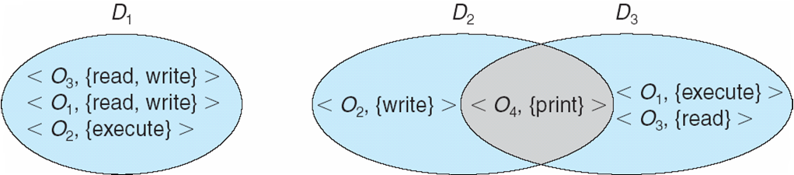
14.3 Domain Structure(保护域)
Access-right = <object-name, rights-set>
访问权限 = <对象名, 权限集> 权限集是对此对象可操作的所有合法操作的一个子集
Domain = set of access-rights 域 = 访问权限的集合
下图中D₂和D₃域存在交集： <O₄, {print}> 由D₂和D₃共享

Slide 8
Domain Structure(保护域)
可以通过不同的途径实现域
每个用户是一个域。访问的对象取决于用户的身份。域切换在更换用户时发生，比如一个用户登出，另一个用户登入
每个进程是一个域。对象集的访问取决于进程的身份。一个进程发送信息给另外一个进程，另外的进程处理时，域发生切换
每个过程是一个域。可以访问的对象集对应这个过程中定义的局部变量。一个过程调用其他过程时，发生域切换

Slide 9
Domain Implementation (UNIX实例)
Domain = user-id 域与用户关联
域切换(用户临时身份切换)由文件系统完成
每个文件有一域位(setuid bit)与文件所有者相关联
当文件被执行，且 setuid 位打开时，则指向该文件的用户id被临时赋予文件所有者的id
文件执行结束，恢复执行者的原id
通过口令切换域
su command temporarily switches to another user’s domain when other domain’s password provided
Domain switching via commands
sudo command prefix executes specified command in another domain (if original domain has privilege or password given)

Slide 10
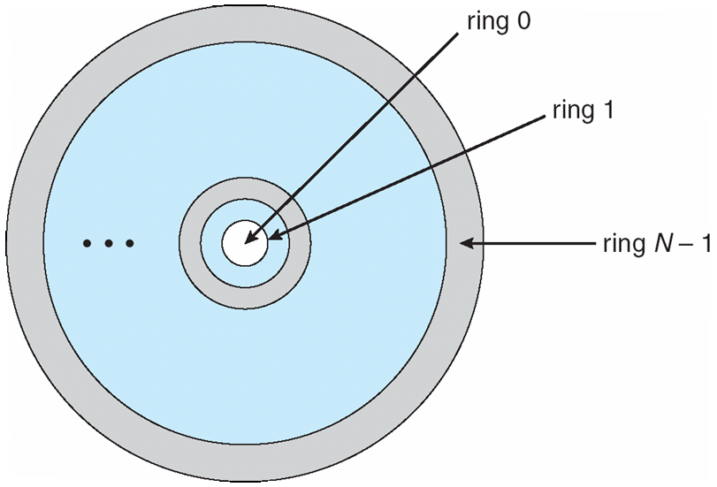
Domain Implementation (MULTICS)
设 D_{i} 与 D_{j} 是任意2个域ring
If j < i ⇒ D_{i} ⊆ D_{j} ，D_{i} 是D_{j} 的子集，号数小的ring，拥有更多的权限，ring 0 权限最大

Slide 11
Multics Benefits and Limits
Ring / hierarchical structure provided more than the basic kernel / user or root / normal user design
Fairly complex -> more overhead
But does not allow strict need-to-know
Object accessible in D_{j} but not in D_{i}, then j must be < i
But then every segment accessible in D_{i} also accessible in D_{j}

Slide 12
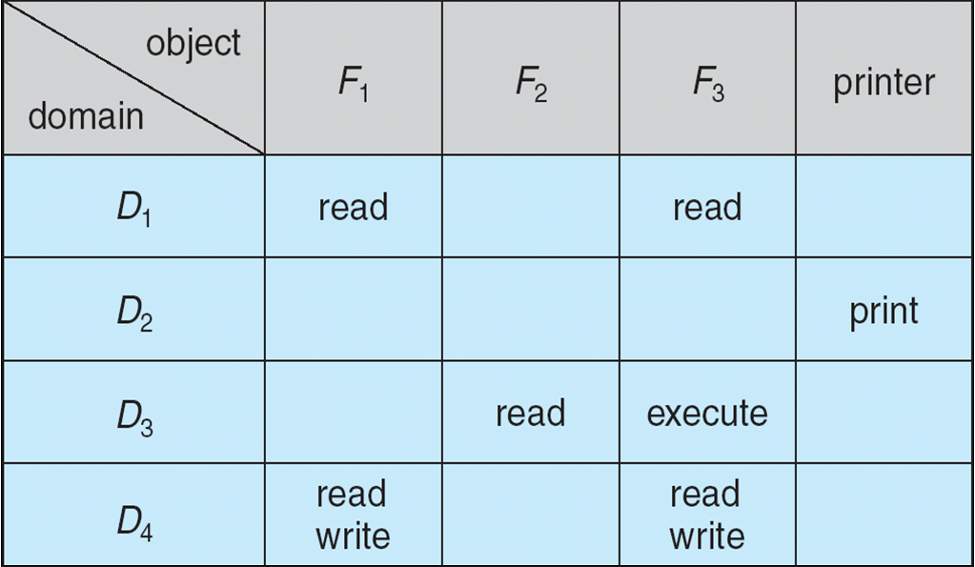
14.4 Access Matrix(访问矩阵)
将保护模型表示为矩阵 (access matrix，访问矩阵)
行代表域；列代表对象
访问条目 Access(i, j) 定义了在域D_{i} 中执行的进程在调用对象Object_{j}时，被允许执行的操作集合

Slide 13
Use of Access Matrix
若在域 D_{i} 中运行的进程试图对对象O_{j} 做 “op”操作，那么 “op” 必须在访问矩阵之内
创建对象的用户可以定义该对象所在列的访问权限
switch(切换) – 进程切换到有switch(切换) 权限的其他域
可以扩展为动态保护
增加，删除权限的操作
特别的访问权限：
复制(copy) (由“*”表示) - 将操作从 O_{i} 拷贝至O_{j}
受限复制 – 仅能复制op，但复制权*本身不能复制
迁移(transfer) – 将某个权限从 D_{i} 复制到 D_{j} ，并将D_{i} 的原权限删除
控制(control) – D_{i} 可以修改D_{j} 的访问权限
所有者(owner) - 添加或删除在本列中的权限
复制和域所有者适用于一个对象
控制适用于域

Slide 14
Use of Access Matrix (Cont.)
Access matrix(访问矩阵) 设计分离了机制与策略
Mechanism(机制)
操作系统提供 访问矩阵+规则
需要确保矩阵仅由授权的agents(代理)处理，而且所有规则被严格执行
Policy(策略)
用户指定策略
谁可以以什么模式访问哪些对象
没有解决限制问题(confinement problem，确保一个对象最初持有的信息，不能迁移到对象的执行环境之外)

Slide 15
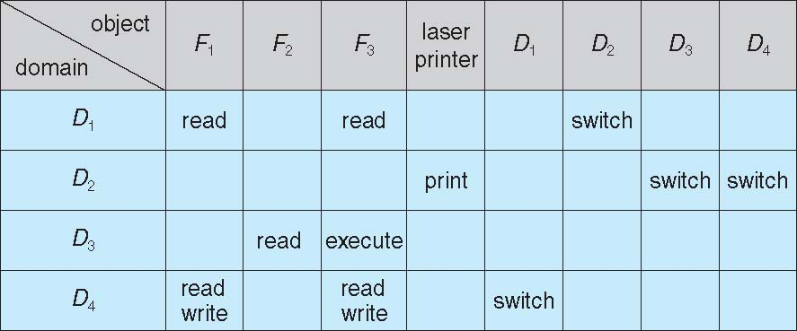
Access Matrix of Figure A with Domains as Objects 将域作为对象的访问矩阵
例如，在域D₂中运行的进程，可以切换到域D₃或D₄

Slide 16
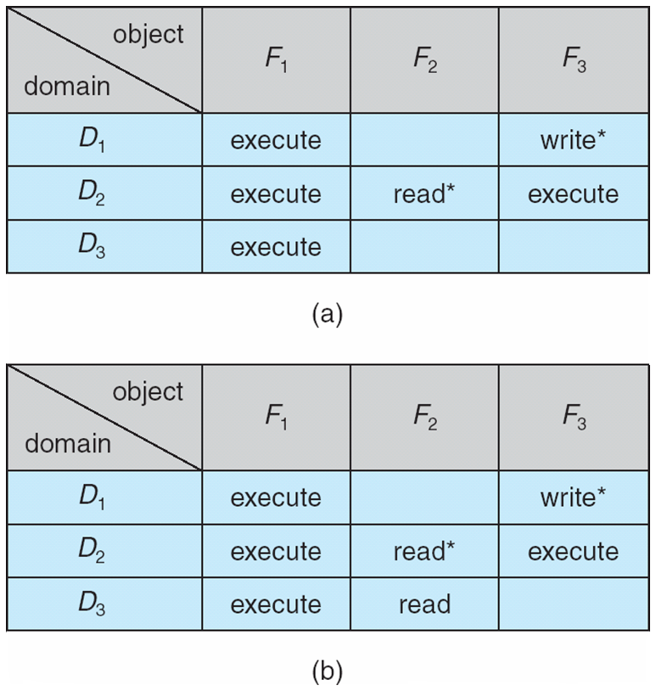
Access Matrix with Copy Rights

Slide 17
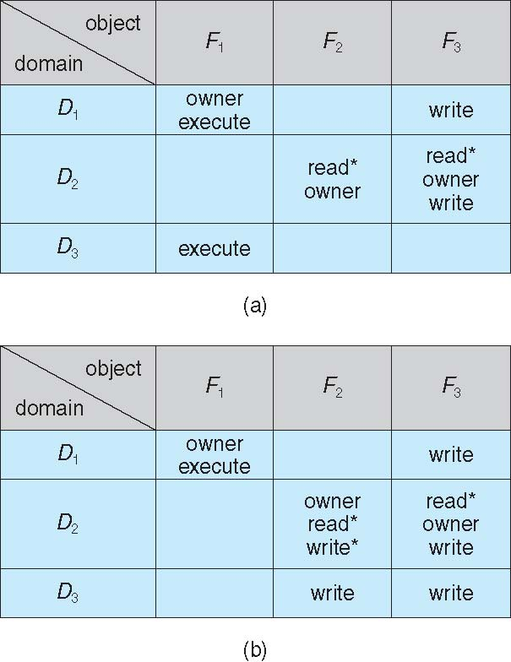
Access Matrix With Owner Rights

Slide 18
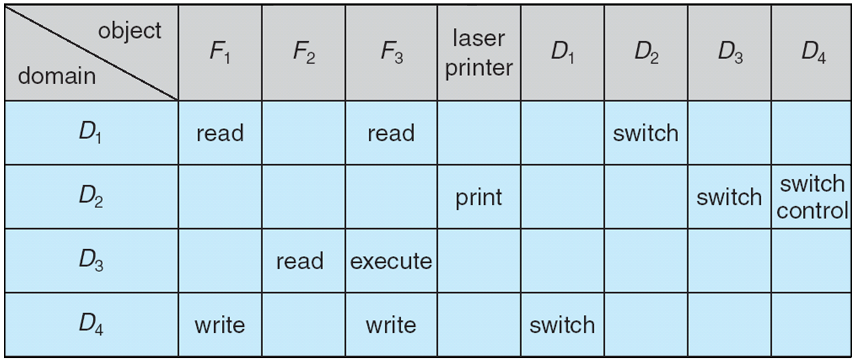
Modified Access Matrix of Figure B
一个在域D₂执行的进程，可以修改域D₄

Slide 19
14.5 Implementation of Access Matrix(访问矩阵的实现)
一般说来，访问矩阵是一个稀疏矩阵
实现 1 – 全局表
表内存储有序三元关系 <domain, object, rights-set>
一个操作 M 在域D_{i} 中作用于对象O_{j} 时 -> 在表中查找< D_{i}, O_{j}, R_{k} >
查找条件是 M ∈ R_{k}
全局表可能很大，以至于内存中难以放下，
难以分组对象 (例如某个对象，每个域都能读，则在全局表中，需要每个域中都出现一次)

Slide 20
Implementation of Access Matrix (Cont.)
实现 2 – 对象的访问列表
访问矩阵的每一列都可以被实现成一个对象的访问列表
每个对象的访问列表由有序对 <domain, rights-set> 组成，定义了所有有着非空访问权限集合的域
容易扩展到包含默认的访问权限集合-> 若M ∈ 默认集合，也允许访问

Slide 21
Implementation of Access Matrix (Cont.)
Each column = Access-control list for one object Defines who can perform what operation Domain 1 = Read, Write Domain 2 = Read Domain 3 = Read
Each Row = Capability List (like a key) For each domain, what operations allowed on what objects
Object F1 – Read
Object F4 – Read, Write, Execute
Object F5 – Read, Write, Delete, Copy

Slide 22
Implementation of Access Matrix (Cont.)
实现 3 – 域的能力列表
Instead of object-based, list is domain based不是基于对象的，列表是基于域的
域的 Capability list(能力列表) 由对象以及允许作用于这些对象上的操作组成
对象通常用其物理名称或地址表示, 被称为 capability(能力)

Slide 23
Implementation of Access Matrix (Cont.)
如果要对对象执行操作M，由程序来执行这个操作，参数为对象的能力(或指针)。
拥有能力，意味着允许访问
能力列表被关联到一个域，但在该域中执行的进程并不能直接地访问它
而是，能力列表是一个被保护的对象，由操作系统持有，被用户间接访问
就像是一个安全指针(“secure pointer”)
这种想法为扩展到应用层次的保护提供了一个良好的基础

Slide 24
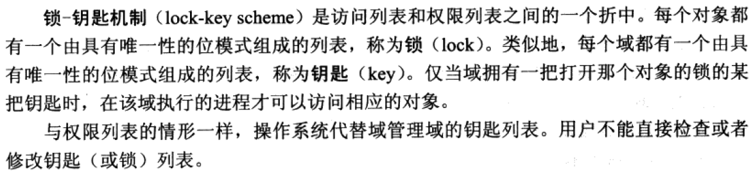
Implementation of Access Matrix (Cont.)
实现 4 – 锁-钥匙机制(Lock-key)

Slide 25

Comparison of Implementations

Slide 26

Comparison of Implementations (Cont.)

Slide 27
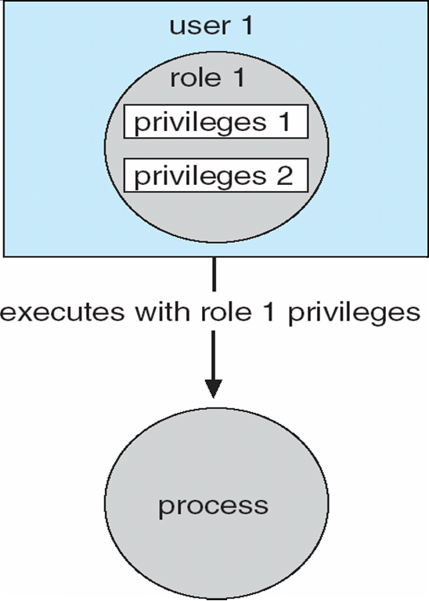
14.6 Access Control(访问控制)
Protection can be applied to non-file resources
Oracle Solaris 10 provides role-based access control (RBAC) to implement least privilege
Privilege is right to execute system call or use an option within a system call
Can be assigned to processes
Users assigned roles granting access to privileges and programs
Enable role via password to gain its privileges
Similar to access matrix

Slide 28
14.7 Revocation of Access Rights(访问权限的撤回)
Various options to remove the access right of a domain to an object
Immediate vs. delayed
Selective vs. general
Partial vs. total
Temporary vs. permanent
Access List – Delete access rights from access list
Simple – search access list and remove entry
Immediate, general or selective, total or partial, permanent or temporary

Slide 29
Revocation of Access Rights (Cont.)
Capability List – Scheme required to locate capability in the system before capability can be revoked
Reacquisition – periodic delete, with require and denial if revoked
Back-pointers – set of pointers from each object to all capabilities of that object (Multics)
Indirection – capability points to global table entry which points to object – delete entry from global table, not selective (CAL)
Keys – unique bits associated with capability, generated when capability created
Master key associated with object, key matches master key for access
Revocation – create new master key
Policy decision of who can create and modify keys – object owner or others?

Slide 30
14.8 Capability-Based Systems(面向权限的系统)
Hydra
Fixed set of access rights known to and interpreted by the system
i.e. read, write, or execute each memory segment
User can declare other auxiliary rights and register those with protection system
Accessing process must hold capability and know name of operation
Rights amplification allowed by trustworthy procedures for a specific type
Interpretation of user-defined rights performed solely by user's program; system provides access protection for use of these rights
Operations on objects defined procedurally – procedures are objects accessed indirectly by capabilities
Solves the problem of mutually suspicious subsystems
Includes library of prewritten security routines

Slide 31
Capability-Based Systems (Cont.)
Cambridge CAP System
Simpler but powerful
Data capability - provides standard read, write, execute of individual storage segments associated with object – implemented in microcode
Software capability -interpretation left to the subsystem, through its protected procedures
Only has access to its own subsystem
Programmers must learn principles and techniques of protection

Slide 32
*14.9 Language-Based Protection(基于语言的保护)
Specification of protection in a programming language allows the high-level description of policies for the allocation and use of resources
Language implementation can provide software for protection enforcement when automatic hardware-supported checking is unavailable
Interpret protection specifications to generate calls on whatever protection system is provided by the hardware and the operating system

Slide 33
Protection in Java 2
Protection is handled by the Java Virtual Machine (JVM)
A class is assigned a protection domain when it is loaded by the JVM
The protection domain indicates what operations the class can (and cannot) perform
If a library method is invoked that performs a privileged operation, the stack is inspected to ensure the operation can be performed by the library
Generally, Java’s load-time and run-time checks enforce type safety
Classes effectively encapsulate and protect data and methods from other classes

Slide 34
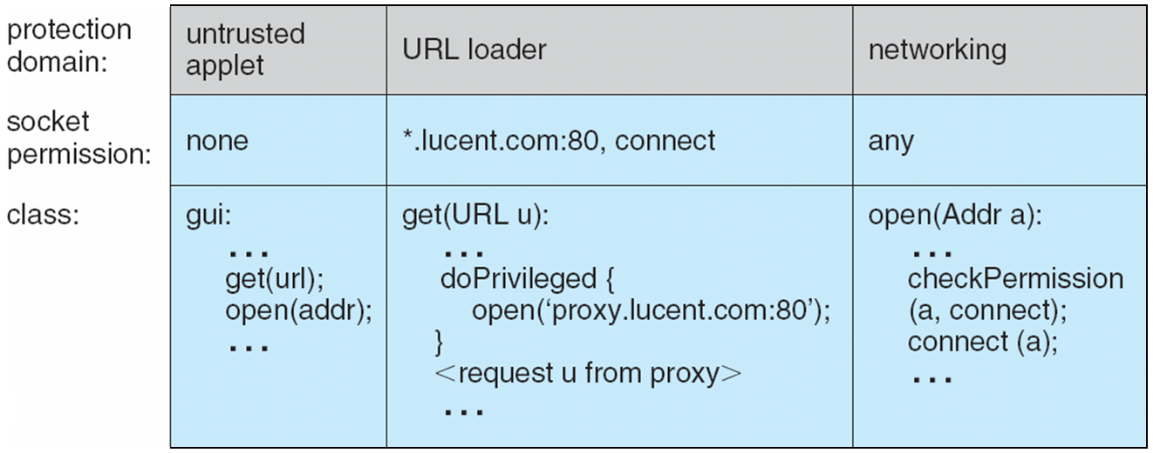
Stack Inspection

Slide 35
Summary 1/4
System protection features are guided by the principle of need-to-know and implement mechanisms to enforce the principle of least privilege.
Computer systems contain objects that must be protected from misuse. Objects may be hardware (such as memory, CPU time, and I/O devices) or software (such as files, programs, and semaphores).
An access right is permission to perform an operation on an object. A domain is a set of access rights. Processes execute in domains and may use any of the access rights in the domain to access and manipulate objects. During its lifetime, a process may be either bound to a protection domain or allowed to switch from one domain to another.

Slide 36
Summary 2/4
A common method of securing objects is to provide a series of protection rings, each with more privileges than the last. ARM, for example, provides four protection levels. The most privileged, TrustZone, is callable only from kernel mode.
The access matrix is a general model of protection that provides a mechanism for protection without imposing a particular protection policy on the system or its users. The separation of policy and mechanism is an important design property.
The access matrix is sparse. It is normally implemented either as access lists associated with each object or as capability lists associated with each domain. We can include dynamic protection in the access-matrix model by considering domains and the access matrix itself as objects. Revocation of access rights in a dynamic protection model is typically easier to implement with an access-list scheme than with a capability list.

Slide 37
Summary 3/4
Real systems are much more limited than the general model. Older UNIX distributions are representative, providing discretionary access controls of read, write, and execution protection separately for the owner, group, and general public for each file. More modern systems are closer to the general model, or at least provide a variety of protection features to protect the system and its users.
Solaris 10 and beyond, among other systems, implement the principle of least privilege via role-based access control, a form of access matrix. Another protection extension is mandatory access control, a form of system policy enforcement.

Slide 38
Summary 4/4
Capability-based systems offer finer-grained protection than older models, providing specific abilities to processes by “slicing up” the powers of root into distinct areas. Other methods of improving protection include System Integrity Protection, system-call filtering, sandboxing, and code signing.
Language-based protection provides finer-grained arbitration of requests and privileges than the operating system is able to provide. For example, a single Java JVM can run several threads, each in a different protection class. It enforces the resource requests through sophisticated stack inspection and via the type safety of the language.

Slide 39
End of Chapter 14: Protection

